Slide 1

Exploring
#4 Logic, If & Switch

Slide 2
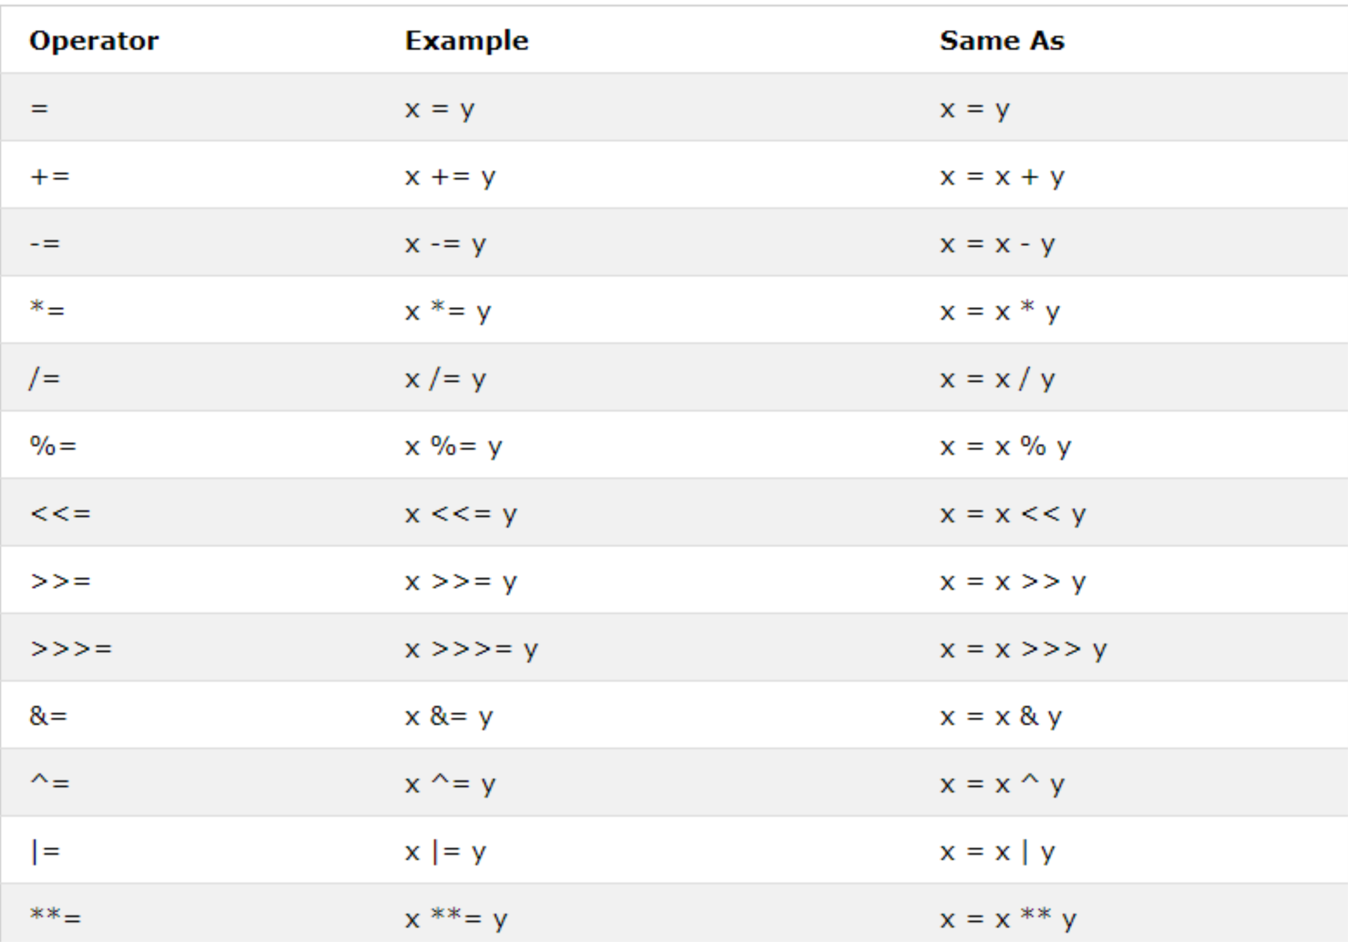
Assignment Operators

Slide 3
Assignment Operators
var usiaAndi = 40;
console.log(usiaAndi *= 2);
console.log(usiaAndi /= 2);
console.log(usiaAndi += 2);
console.log(usiaAndi -= 2);
console.log(usiaAndi %= 2);

Slide 4
Comparison Operators
== value sama, tapi data type beda
=== value & data type sama
> lebih dari
< kurang dari
>= lebih dari sama dengan
<= kurang dari sama dengan
Logical Operators
&& and (keduanya benar, maka TRUE)
|| or (salah satu benar, maka TRUE)
! not (membalik logika TRUE/FALSE)

Slide 5
Comparison
Operators
var x = 5;
var y = '5';
console.log(x == y);
console.log(x === y);
console.log(x > y);
console.log(x >= y);
console.log(x < y);
console.log(x <= y);

Slide 6
Logical
Operators
var x = 5;
var y = '5';
var z = 6;
console.log(x===y && y<z);
console.log(x===y || y<z);
console.log(!(x===y || y<z));

Slide 7
Conditional Statements
What ?
In computer science, conditional statements are features of a programming language, which perform different actions depending on whether a programmer-specified boolean condition evaluates to true or false.
Why ?
Because sometimes we want our program to do different actions depends on the conditions, like example when we press add to cart on an e-commerce application and we aren’t login yet, the program will redirect us to login page, but if we already login, it will add to cart successfully.

Slide 8
Conditional Statements
Very often when you write code, you want to perform different actions for different decisions.
You can use conditional statements in your code to do this.
In JavaScript we have the following conditional statements:
Use if to specify a block of code to be executed, if a specified condition is true
Use else to specify a block of code to be executed, if the same condition is false
Use else if to specify a new condition to test, if the first condition is false
Use switch to specify many alternative blocks of code to be executed

Slide 9
if, else if & else
if (condition) {program;}
else if (condition) {program;}
else {program;}

Slide 10
if, else if & else
var nilai = 92;
if (nilai > 80) {
console.log('Excellent!');
} else if (nilai >= 60 && nilai <= 80){
console.log('Good job!');
} else {
console.log('Don\’t give up!');
}

Slide 11
if, else if & else
let jomblo = true;
if (jomblo) {
console.log('Masih jomblo!');
}
else {
console.log('Udah taken!');
}

Slide 12
Switch
var job = 'guru';
switch (job) {
case 'guru':
console.log('Kerjaannya ngajar.');
break;
case 'sopir':
console.log('Kerjaannya nyetir.');
break;
case 'polisi':
console.log('Kerjaannya nilang.');
break;
default:
console.log('Ada aja kerjaannya.');
}

Slide 13
Switch
<script>
var job;
job = prompt('Apa profesi Anda?');
switch (job) {
case 'guru':
console.log('Kerjaannya ngajar.');
break;
case 'sopir':
console.log('Kerjaannya nyetir.');
break;
case 'polisi':
console.log('Kerjaannya nilang.');
break;
default:
console.log('Ada aja kerjaannya.');
}
</script>

Slide 14
let alaskaki = 'sepatu';
let warna = 'merah';
switch (true) {
case (alaskaki == 'sepatu' && warna == 'merah'):
console.log('Saya suka sepatu merah.');
break;
case (alaskaki == 'sepatu' && warna == 'biru'):
console.log('Saya suka sepatu biru.');
break;
case (alaskaki == 'sandal' && warna == 'merah'):
console.log('Saya suka sandal merah.');
break;
case (alaskaki == 'sandal' && warna == 'biru'):
console.log('Saya suka sandal biru.');
break;
default:
console.log('Tak suka alas kaki merah/biru.');
}
Switch
2 Variabel

Slide 15
Learning Resources
https://www.w3schools.com/js/js_comparisons.asp
https://www.w3schools.com/js/js_if_else.asp
https://www.w3schools.com/js/js_switch.asp

Slide 16

Solve It!
$$\text{Switch}\text{ 3 }\text{Var}$$
alas: sandal / sepatu
warna: merah / biru
harga: murah / mahal

Slide 17
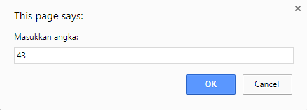
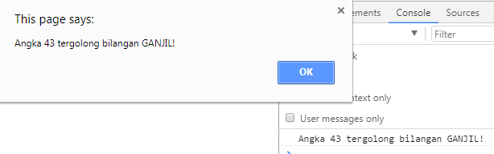
Solve It with IF then SWITCH! #10

Slide 18
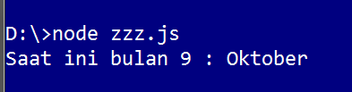
bit.ly/jc04fundamental
Dengan object Date() dan If,
tentukan nama Bulan saat ini!

Slide 19

Solve It! #12
Dengan object Date() dan If,
tentukan hari & tanggal saat ini!

Slide 20
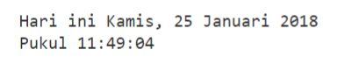
Solve It! #12
Dengan object Date() dan If,
tentukan waktu saat ini!

Slide 21
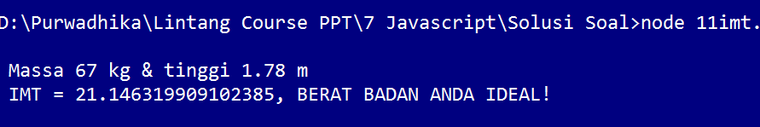
Solve It! #13
IMT = massa(kg) / tinggi(meter)^2
a. IMT < 18.5 artinya berat badan kurang,
b. 18.5 - 24.9 artinya berat badan ideal,
c. 25.0 - 29.9 artinya BB berlebih,
d. 30.0 - 39.9 artinya BB sangat berlebih,
e. IMT > 39.9 artinya obesitas.

Slide 22
Exploring
#4 Logic, If & Switch

